Slide 1





Team Members:-
Doctor Appointment Booking Website
Suryansh Ambekar | suryansh.ambekar@mitaoe.ac.in
Kaustubh Mahajan | kaustubh.mahajan@mitaoe.ac.in
Mayank Soni | mayank.soni@mitaoe.ac.in
Tuhinansh Sharma | tuhinansh.sharma@mitaoe.ac.in
Guide: Kaushal Joshi
Disclaimer: The content is curated for educational purposes only.
Notes:
Slides: Prepare a short slide deck (10-12 slides) summarizing the project objectives, methodology, and key results.

Slide 2
Doctor Appointment Booking Website
OUTLINE
Abstract of the Project
Problem Statement
Proposed Solution
System Architecture
Live Demo of the Project
Embedded Video of Project
Conclusion
Future Scope

Slide 3
Abstract
Doctor Appointment Booking Website
The website simplifies doctor-patient interactions by enabling online appointment bookings, profile management, and administrative oversight.
It utilizes the MERN stack to deliver a responsive, interactive, and secure system.

Slide 4
Problem Statement
Doctor Appointment Booking Website
Managing doctor-patient interactions can be challenging due to the limitations of manual appointment booking systems. These systems often lack efficiency, accuracy, and the ability to centralize doctor and patient profiles. Furthermore, the absence of an organized digital platform makes it difficult for administrators to oversee operations effectively. Addressing these issues requires a modern, scalable, and user-friendly web-based solution.

Slide 5
Proposed Solution
Doctor Appointment Booking Website
The website allows patients to book appointments online 24/7.
Patients can view their appointment history and cancel appointments online.
Doctors can manage their appointments and profiles online.
Administrators can manage doctor profiles and patient records online.

Slide 6
System Architecture
Doctor Appointment Booking Website
Frontend (Client-Side)
Built using React.js, providing a dynamic, responsive, and interactive user interface.
Features implemented include:
Home Page: Displays general information about the application and its functionality.
About Page: Provides details about the platform, its purpose, and how to use it.
Doctors Page: Lists available doctors with filters for specialties, making it easy for patients to find the right doctor.
Appointment Booking: Allows patients to schedule appointments with their chosen doctors.
User Authentication: Enables login and signup functionality for patients and doctors.

Slide 7
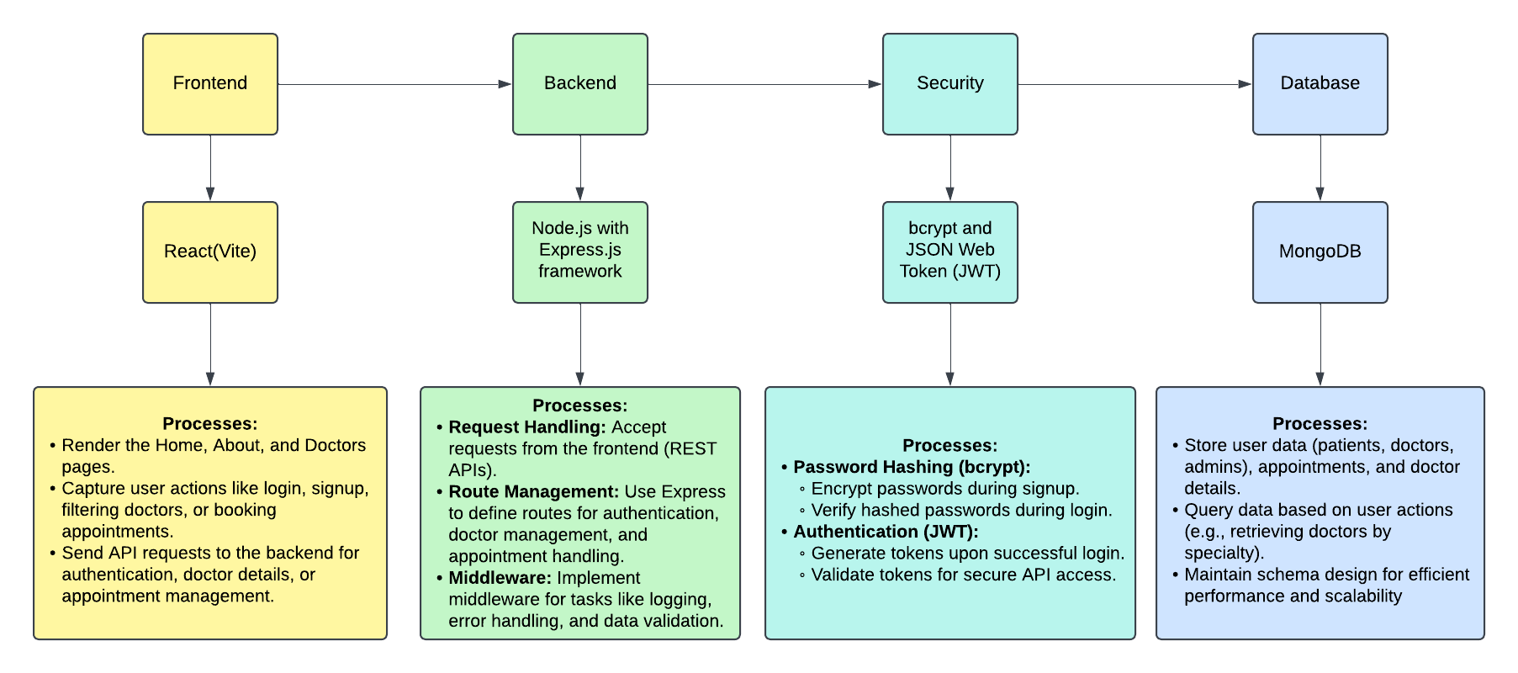
System Architecture
Doctor Appointment Booking Website

Slide 8
System Architecture
Doctor Appointment Booking Website
Backend (Server-Side)
Developed using Node.js with Express.js as the framework for API routing and request handling.
Features implemented include:
Authentication: Used bcrypt for securely hashing passwords and JWT (JSON Web Tokens) for user authentication and session management.
Doctor Management:
APIs to add or remove doctors.
Appointment Handling: APIs for creating, updating, and deleting patient appointments.
Database:
Used MongoDB for storing user data (patients, doctors, and admin), appointment details, and doctor information.
Ensured schema design optimizes queries for better performance.

Slide 9
System Architecture
Doctor Appointment Booking Website
Admin Panel
A dedicated section of the frontend built to provide admin-level control and management.
Features implemented include:
Manage Appointments: Allows the admin to cancel or modify appointments as required.
Doctor Management: Enables the admin to add, update, or remove doctor profiles and their availability.
System Monitoring: Admin can view overall platform statistics (optional for advanced tracking).

Slide 10
Live Demo of Project
Doctor Appointment Booking Website
GitHub Link of the Project: https://github.com/kaudrubh/b9gWNX4YPifGj5efwQ2cvx.git
Video Recording of Project: https://drive.google.com/drive/folders/1sYFPTPpyEjy0BD-zOA5DkWic3xyZEGV-?usp=sharing
Deployed Render Link:
User Page:-https://b9gwnx4ypifgj5efwq2cvx-frontend.onrender.com
Admin Page:-https://b9gwnx4ypifgj5efwq2cvx-frontend.onrender.com

Slide 11
Conclusion
Doctor Appointment Booking Website
The system streamlines the appointment booking process, saving time and effort.
Provides a user-friendly and secure platform for all stakeholders.
Demonstrates the effectiveness of the MERN stack for full-stack application development.

Slide 12
Future Scope
Doctor Appointment Booking Website
Adding teleconsultation features for remote consultations.
AI-based doctor recommendations based on patient symptoms.
Integration with electronic health record systems (EHR).
Multilingual support to cater to a wider audience.
Online payment integration for hassle-free and secure transactions.

Slide 13
References:-
Doctor Appointment Booking Website
•React Documentation: https://reactjs.org/docs/getting-started.html
•Node.js Documentation: https://nodejs.org/en/docs/
•Express Documentation: https://expressjs.com/
•MongoDB Documentation: https://www.mongodb.com/docs/
•JWT Authentication: https://jwt.io/introduction
•MERN Stack Tutorials: https://www.freecodecamp.org/news/learn-the-mern-stack/
•Web App Security Best Practices: https://owasp.org/
•Agile Development for Projects: https://www.atlassian.com/agile

Slide 14
Doctor Appointment Booking Website
Thank you!
Notes:
thank you very much for joining this PPT, keep learning.
‹#›

